Slide 1
HTML – img tag,formatting tag,semantic,list

Slide 2

SEMANTIC ELEMENTS

Slide 3
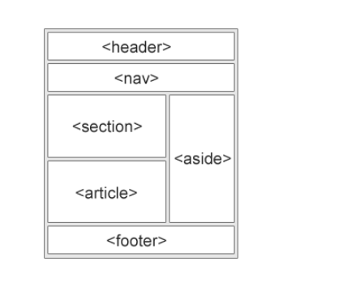
Semantic elements

Slide 4

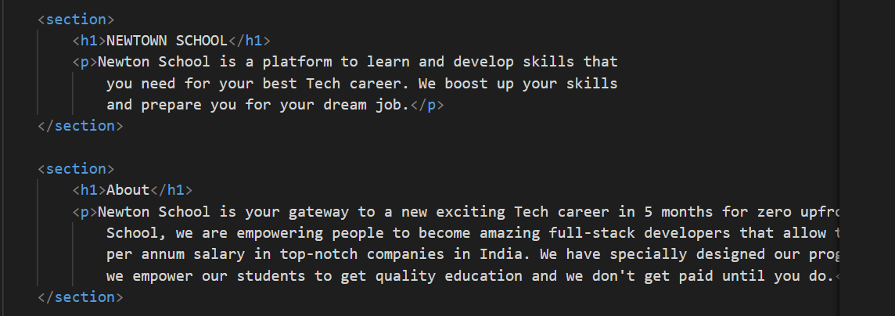
SECTION

Slide 5


HEADER

Slide 6
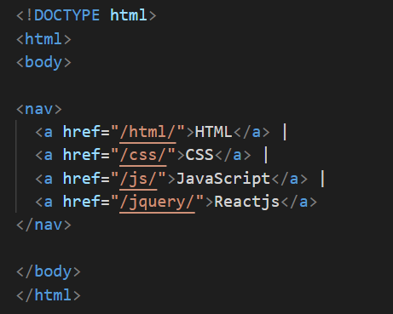

NAV

Slide 7
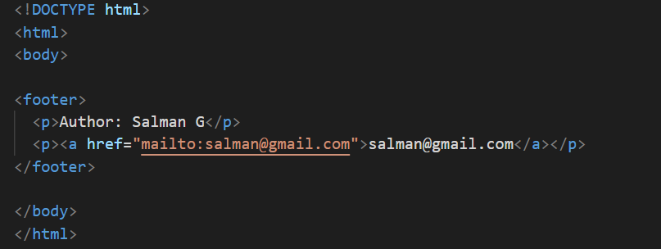
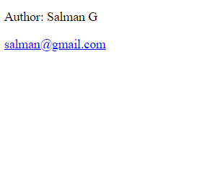
FOOTER

Slide 8

Sidebar menu

Slide 9

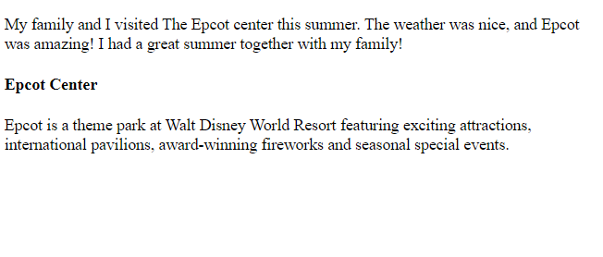
ASIDE

Slide 10
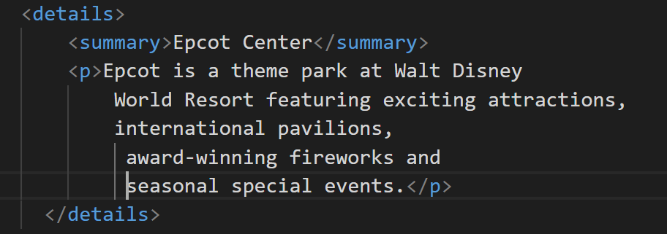



Slide 11

Main tag

Slide 12
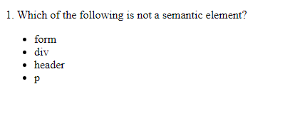
Question

Slide 13
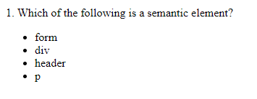
Question

Slide 14

Question

Slide 15
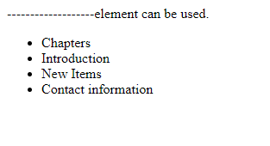
Question

Slide 16
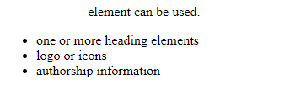
Question

Slide 17
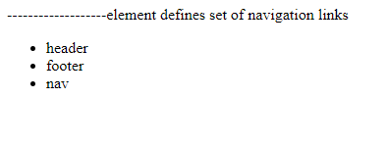
Question

Slide 18

Question

Slide 19
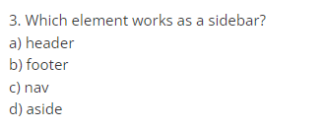
Question

Slide 20

Question

Slide 21
HTML Elements continue..
HTML Lists
HTML lists are defined with the <ul> (unordered/bullet list) or the <ol> (ordered/numbered list) tag, followed by <li> tags (list items):
<ul> <li>Coffee</li> <li>Tea</li> <li>Milk</li> </ul>
<ol> <li>Coffee</li> <li>Tea</li> <li>Milk</li> </ol>

Slide 22
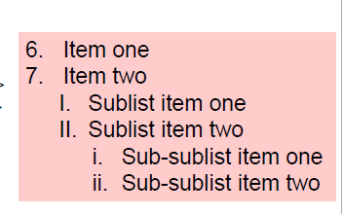
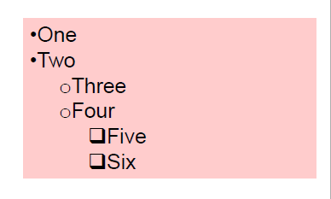
List

Slide 23
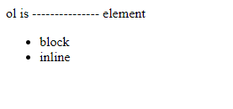
Question

Slide 24
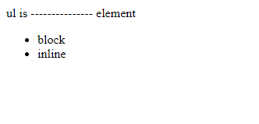
Question

Slide 25

Question

Slide 26

Question

Slide 27

Question

Slide 28
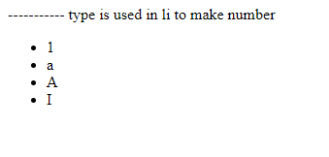
Question

Slide 29
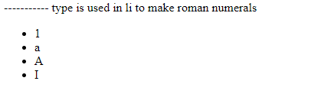
Question

Slide 30
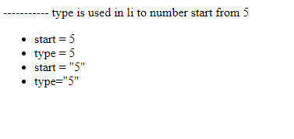
Question

Slide 31

Media – audio Tag

Slide 32
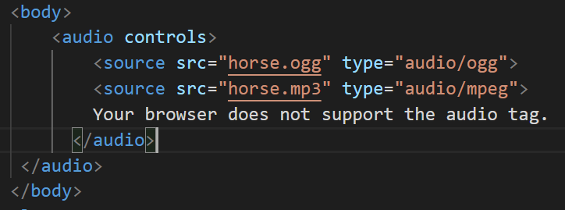

Media tag

Slide 33

Other format audio tag

Slide 34

Media – video tag

Slide 35

Media tag

Slide 36

Iframe

Slide 37
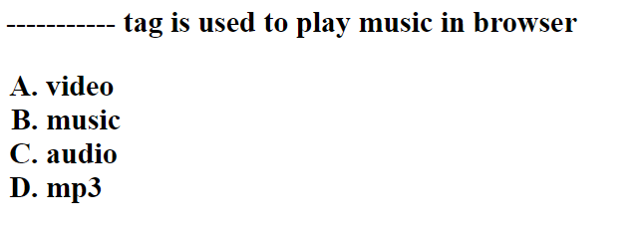
Question

Slide 38
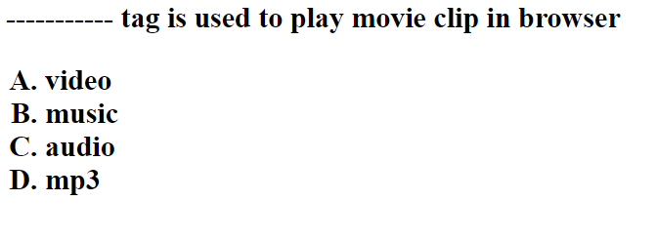
Question

Slide 39

Question

Slide 40

Question

Slide 41

Question

Slide 42
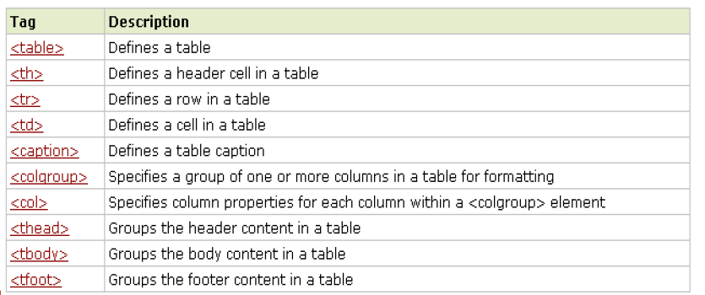
Table

Slide 43
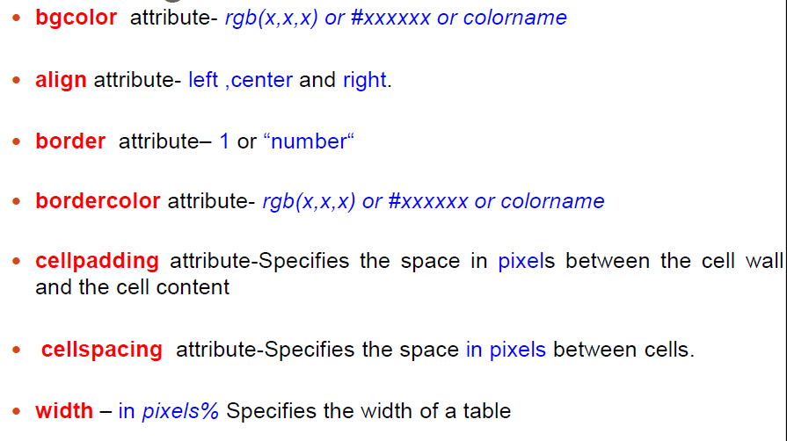
Attributes

Slide 44
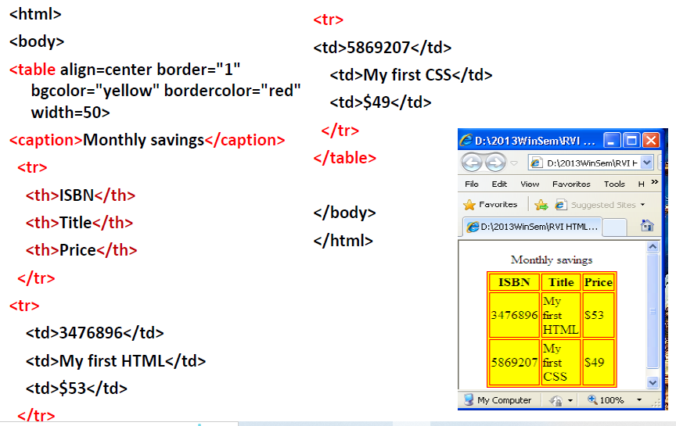
Example

Slide 45
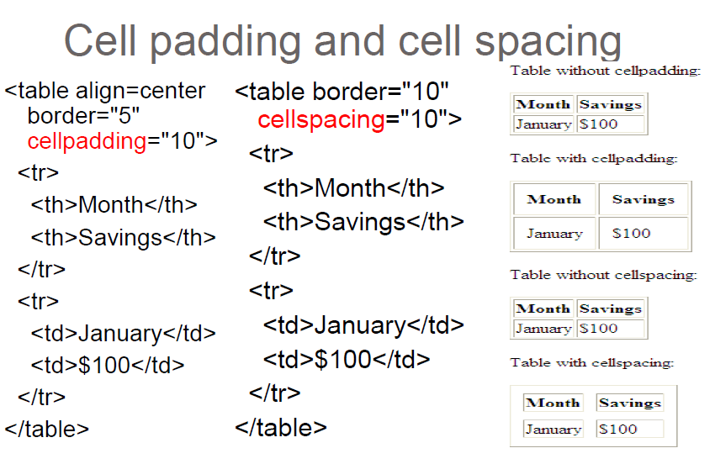
Attributes

Slide 46
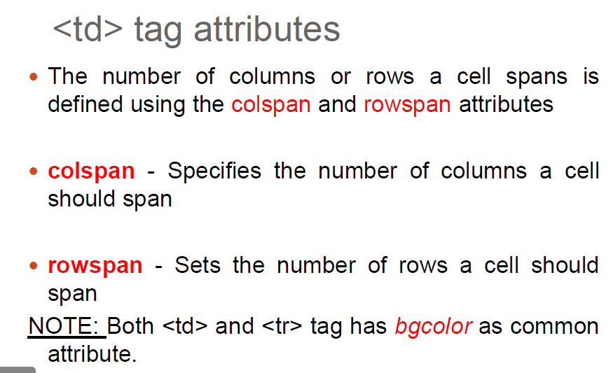
Attributes

Slide 47
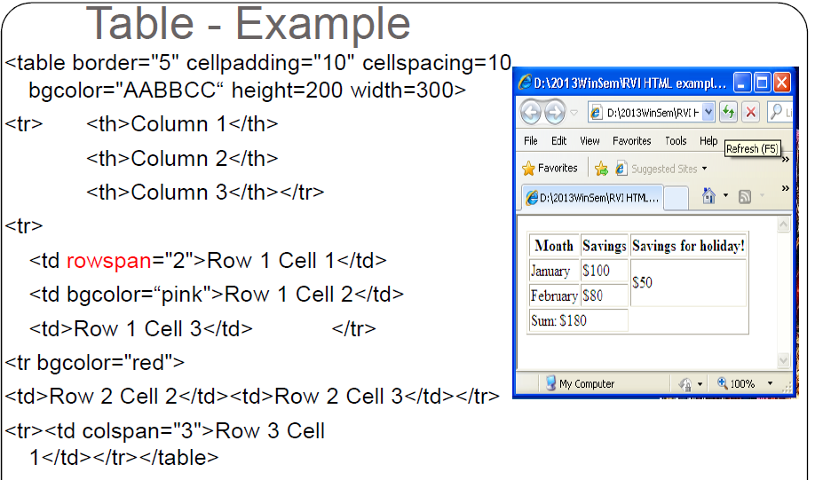
Rowspan and colspan

Slide 48
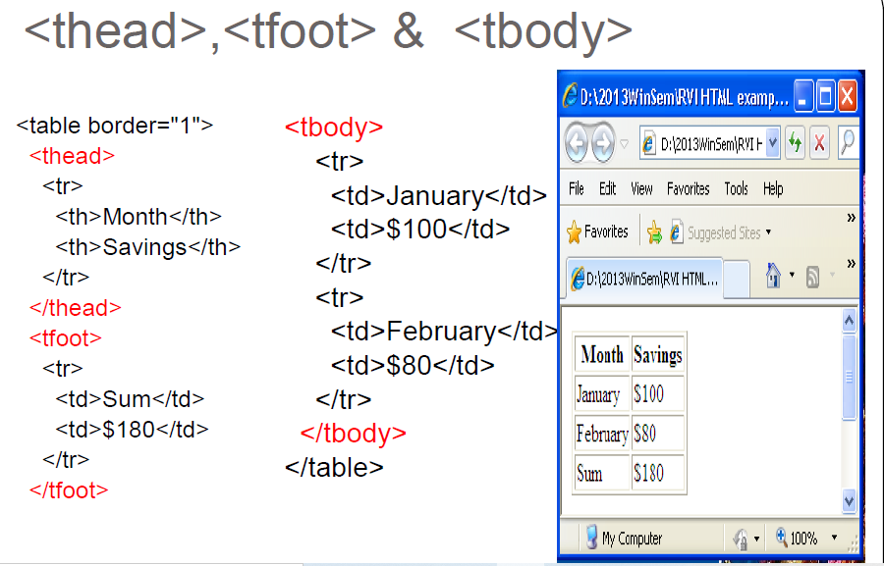

Slide 49
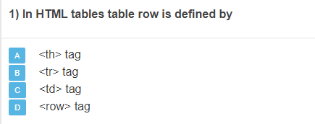
Question

Slide 50
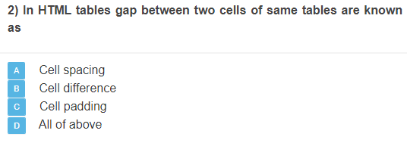
Question

Slide 51
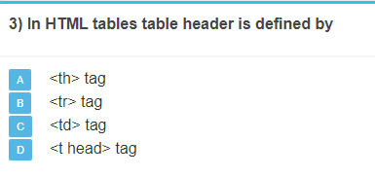
Question

Slide 52
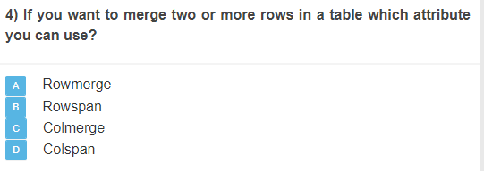
Question

Slide 53
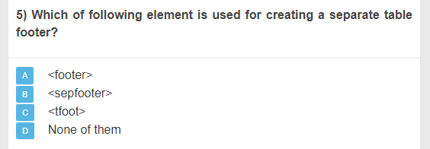
Question

Slide 54
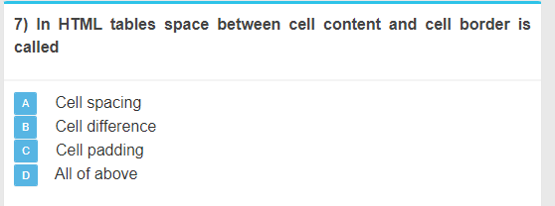
Question

Slide 55
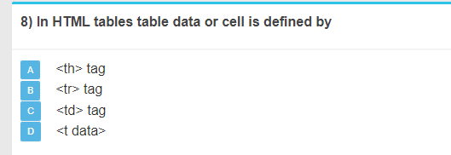
Question

Slide 56
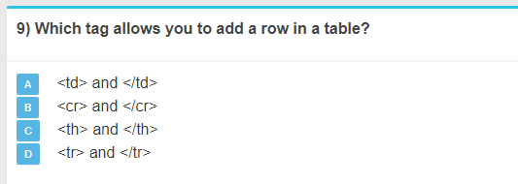
Question

Slide 57
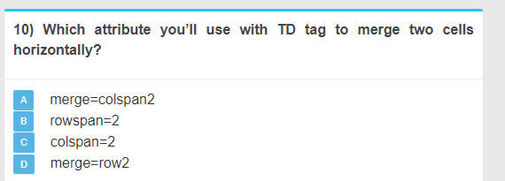
Question

